Slide 1
Modul - Internet of Things (IoT) - 02-Vorlesung
Prof. Dr. Marcel Tilly
Fakultät Informatik, Cloud Computing

Slide 2
Überblick
21. März Einführung in das Internet der Dinge
28. März IoT Architekturen
4. April Things und Sensoren
11. April From Device to Cloud
18. April Vorlesungsfrei – Ostern
25. April IoT Analytics
02. Mai Big Data in IoT
9. Mai Data Exploration
16. Mai IoT Platformen
23. Mai Entwicklung einer IoT Lösung
30. Mai Vorlesungsfrei; Christi Himmelfahrt
05. Juni opt. Gastvortrag – Digitalisierung
13. Juni Data Science in IoT
20. Juni Vorlesungsfrei – Fronleichnam
27. Juni Intelligente Cloud und intelligente Edge
04. Juli PStA Abschlusspraesentationen
PStA

Slide 3
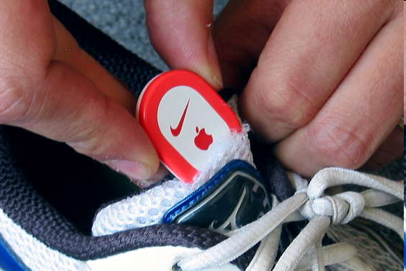
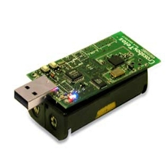
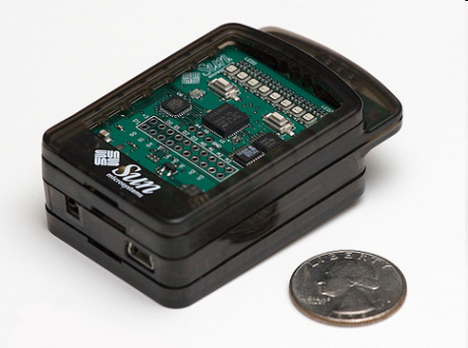
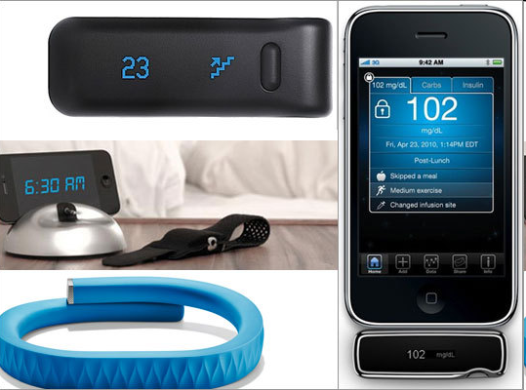
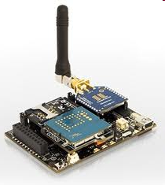
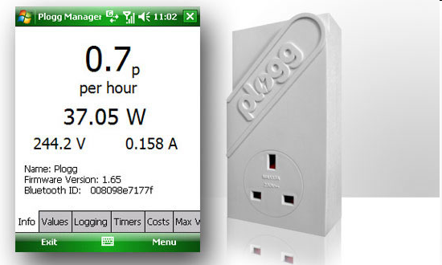
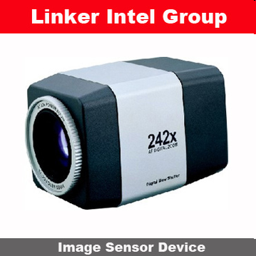
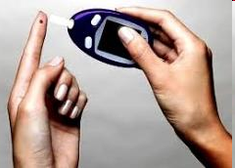
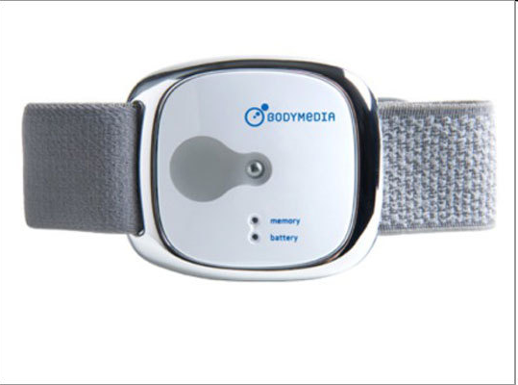
Sensor devices are becoming widely available
- Programmable devices
- Off-the-shelf gadgets/tools

Slide 4
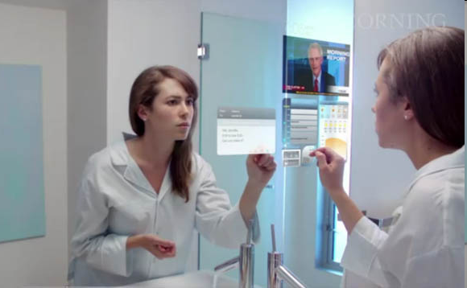
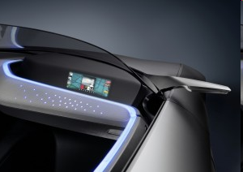
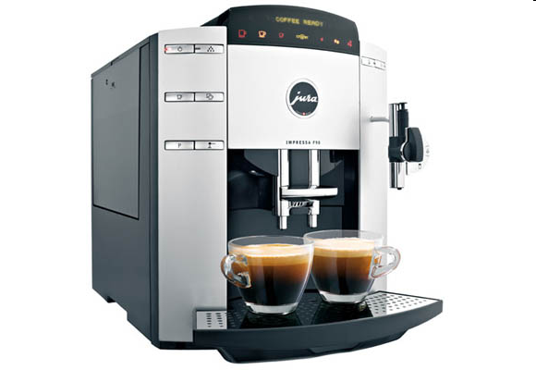
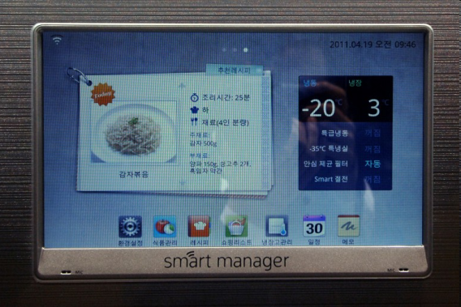
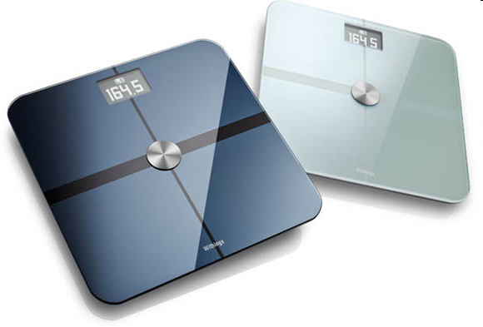
More Things
Home/daily-life devices
Business and
Public infrastructure
Health-care
…

Slide 5
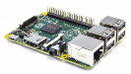
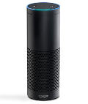
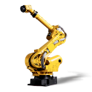
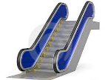
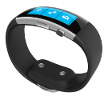

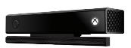
Things
Challenges
Technology
Memory
Processor
Energy (Battery) , lifetime
Security
Various generations (old vs new)
Heterogeneous platforms
Provisioning
Variety of device categories (sensor, gateways)
Variety of device types
Programming languages
Physical size
Inputs
Connectivity
Microcontroller vs OS powered
C, Java, Python, JavaScript, C++, C#, ….

Slide 6
Initial thoughts about ‘Things’
We can turn almost every object into a “thing”.
A “thing” still looks much like an embedded system currently.
A “thing” generally consists of four main parts:
Sensors & actuators
(Micro) - Controller
Communication unit
Power supply
To be discussed:
A “thing” has the following properties:
It’s generally powered by battery: This implies limited source of energy.
It’s generally small in size and low in cost: This limits their computing capability.
It doesn’t usually perform complicated tasks.
Power consumption is the main design issue.

Slide 7
‚Thing‘ Setup
Memory
Processor
Energy (Battery) , lifetime
Security
-> Various generations (old vs new)
Heterogeneous platforms
-> Provisioning
-> Variety of device categories (sensor, gateways)
-> Variety of device types
Programming languages
Physical size
Inputs
Connectivity
Sensor(s)
Actor(s)
Controller
Memory
RAM
Flash
IO
ADC
Communication
Power unit
ADC = Analog-to-digital converter

Slide 8
‚Thing‘ Setup
A ‘thing’ consists of several components
Controller: Central processing unit (CPU)
Memory for application and data
Usually different memory types are used for application and data
Communication interface
Wireless radio interface with antenna
Wired
Sensors/Actors
Interface to the real world
Monitoring, changing of real world phenomena
Power unit
Power supply for all the components

Slide 9
Controller
Four important factors for the controller
Number of transistors -> size, cost, power
Number of clock cycles -> power
Time to develop -> cost, acceptance
Nonrecurring engineering cost (NRE) -> cost, acceptance
Ideal: Minimize all factors at the same time!

Slide 10
Controller Types
The controller is the Central Processing Unit (CPU) of the device
Different architectures possible
Microcontroller (MCU)
Resource constrained compared to desktop processors
Software controlled, general purpose
Digital Signal Processor (DSP)
Processing of large data streams, parallelizing
Hard-wire basic functions
Field-Programmable Gate Arrays (FPGA)
Special hardware, expensive
Limit coding to configuration
Application-Specific Integrated Circuits (ASIC)
Special hardware designed only for one application
Possibly embedding several MCU or DSP cores
General purpose CPU
Resource consuming but flexible
Software controlled

Slide 11
Controller
 | Time to Market | Perfor-mance | Price | Develop-ment Ease | Power | Features Flexibility
MCU | Excellent | Fair | Excellent | Good | Fair | Excellent
DSP | Excellent | Excellent | Good | Excellent | Excellent | Excellent
FPGA | Good | Excellent | Poor | Excellent | Poor | Good
ASIC | Poor | Excellent | Excellent | Fair | Good | Poor
CPU | Excellent | Excellent | Good | Excellent | Poor | Excellent

Slide 12
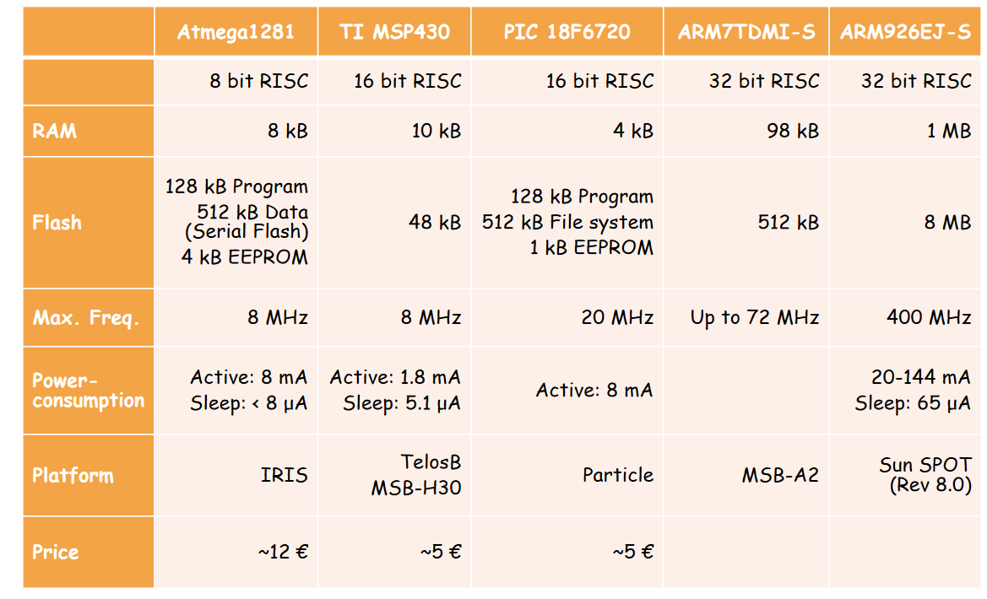
Overview of some MCUs

Slide 13
Memory
Properties
Often different program and data memory
No memory management unit (MMU) available
Size of memory varies
May depend on the application
Types of memory
Random Access Memory (RAM)
Store temporarily sensor data and messages
Electrically Erasable Programmable Read-Only Memory (EEPROM)
Stores the program code
Operates on bytes
FLASH Memory
Non-volatile memory
Stores the program code
Stores data if RAM too small or protection against power loss required
Operates on blocks (read, write)
High delay and energy consumption

Slide 14
Communication interface
Communication interface is required to exchange data with other devices
Typical communication media
Radio
Bluetooth, ZigBee, WiFi, LORA, …
Infrared (IR)
Directed / undirected
Ultrasonic
More in military applications
Sound
Underwater communication
Communication interface has high energy consumption
Radio interface consumes the most energy usually

Slide 15
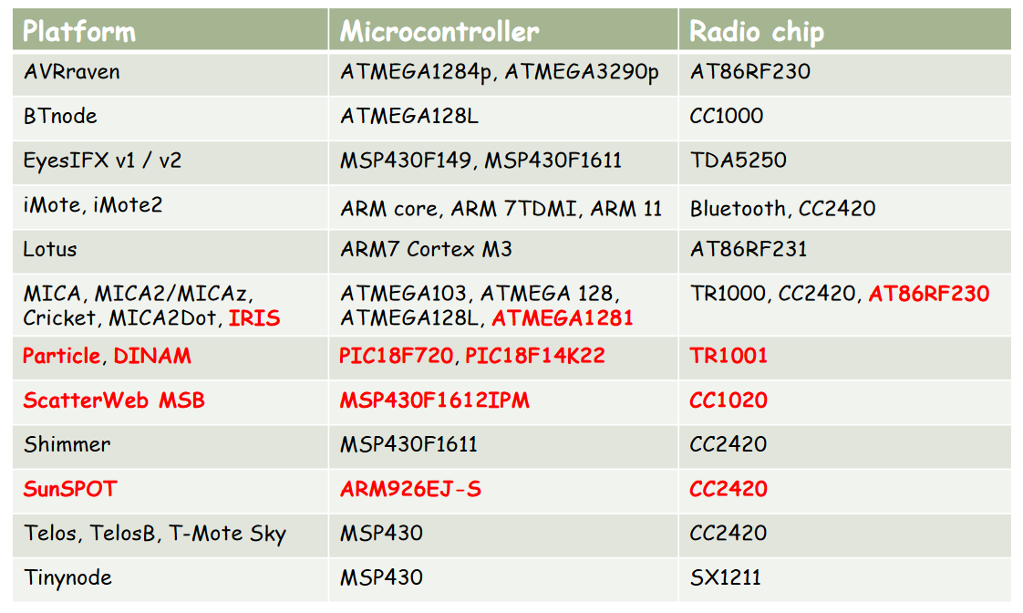
Platforms Overview

Slide 16
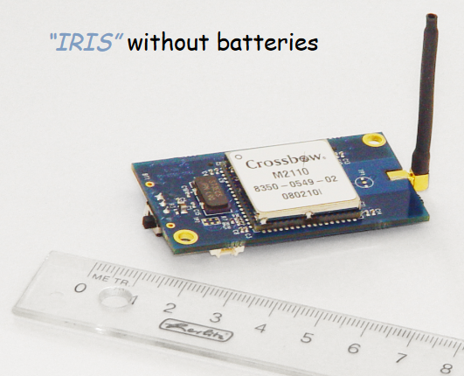
Platforms: IRIS Motes
Processor
XM2110CA based on Atmel ATmega1281
8 bit Microcontroller
8 MHz
Compute power similar to 8088 CPU from the original IBM PC (~1982), but reduced energy consumption
Radio chip
AT86RF230
IEEE 802.15.4
ZigBee compatible
2.4 GHz, 250 kbps, up to 300 m (outdoor), up to 50 m (indoor)
Memory
4 kB EEPROM
8 kB RAM
128 kB program Flash Memory
512 kB measurement Flash Memory

Slide 17
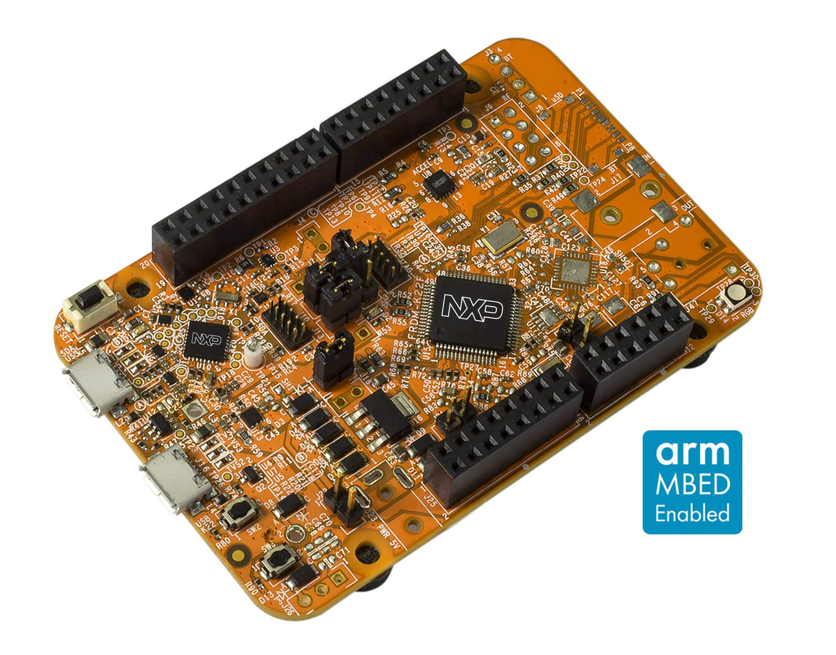
Plattform: Freedom Development Boards
Processor
MK22FN512VLH12 MCU
120 MHz
512 KB flash memory
128 KB RAM
low-power, and crystal-less USB in 64 LQFP package
Radio
Optional header for add-on RF module: nRF24L01+ Nordic 2.4 GHz radio
Optional header for add-on Bluetooth module: JY-MCU BT board V1.05 BT

Slide 18
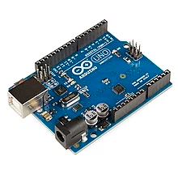
Plattform: Arduino Uno
Processor
Microchip ATmega328P
SRAM: 2 KB
EEPROM: 1 KB
Clock Speed: 16 MHz
Flash Memory: 32 KB of which 0.5 KB used by bootloader
Radio
No Radio default but everything is available as breakouts

Slide 19
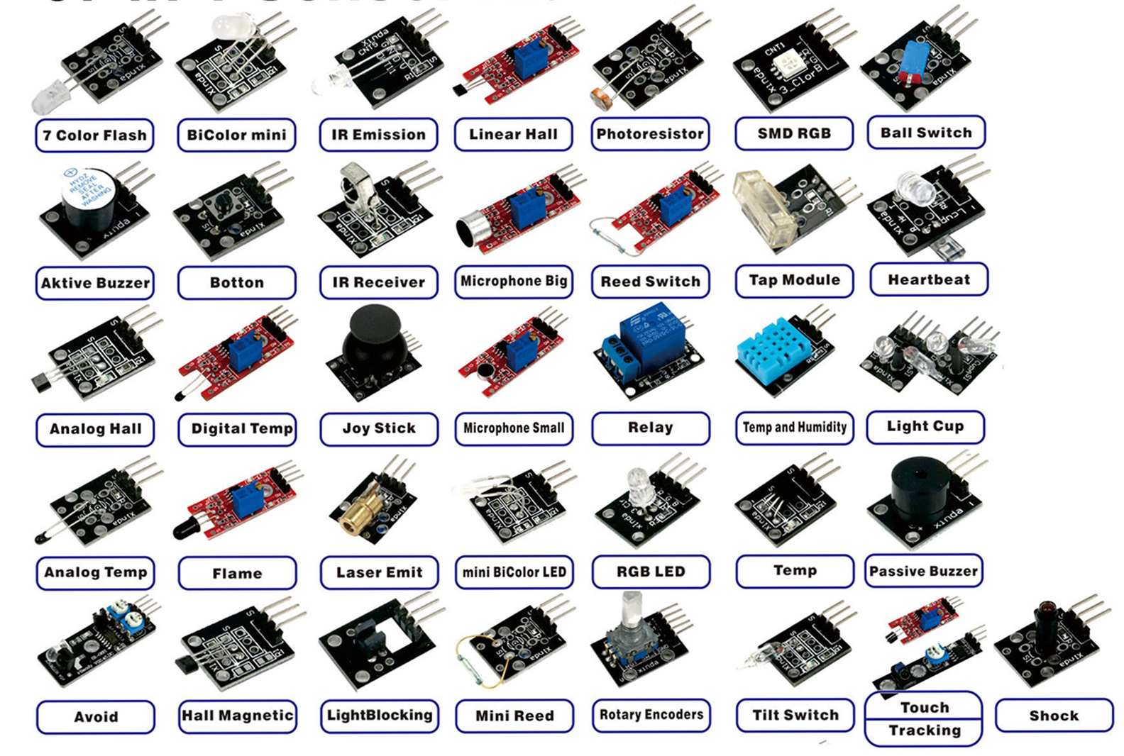
Sensors available in Market

Slide 20
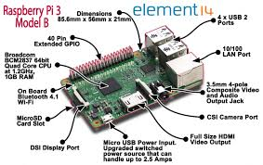
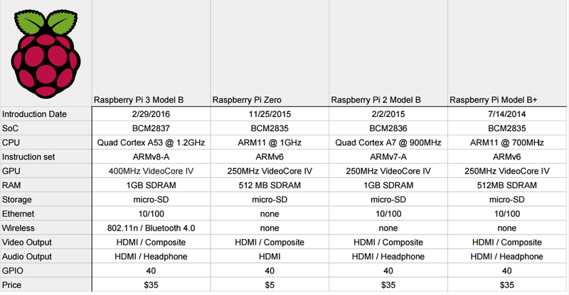
Plattform: Raspberry Pi

Slide 21
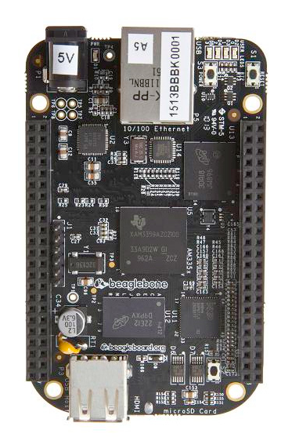
Plattform: Beagle Bone
Processor
AM335x 1GHz ARM® Cortex-A8
512MB DDR3 RAM
4GB 8-bit eMMC on-board flash storage
3D graphics accelerator
NEON floating-point accelerator
2x PRU 32-bit microcontrollers
Connectivity
USB client for power & communications
USB host
Ethernet
HDMI
2x 46 pin headers
Software
Debian
Android
Ubuntu

Slide 22
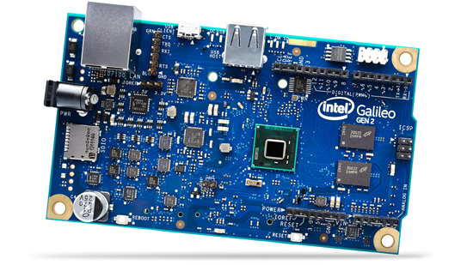
Plattform: Intel Galileo
Processor
1 Core 32-bit Intel Pentium processor-compatible ISA Intel Quark SoC X1000
400 MHz
16 KB L1 Cache
512 KB SRAM
Integrated real-time clock (RTC)
Storage
8 MB NOR Flash for firmware and bootloader
256 MB DDR3; 800 MT/s
SD card, up to 32 GB
8 KB EEPROM
Connectivity
USB 2.0
RJ45 Ethernet
10-pin JTAG for debugging
6-pin UART
6-pin ICSP
1 mini-PCI Express slot
1 SDI

Slide 23
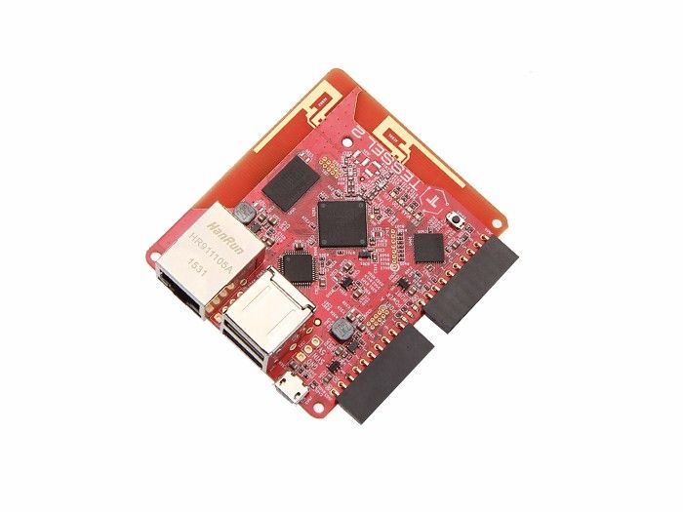
Plattform: Tessel
Procesor
580MHz Mediatek MT7620n
48MHz Atmel SAMD21 coprocessor
64 MB DDR2 RAM & 32 MB Flash
Plenty of space for your code
Connectivity
802.11 b/g/n Wi-Fi
Ethernet
Programming Language
JavaScript

Slide 24
Some Project Ideas

Slide 25
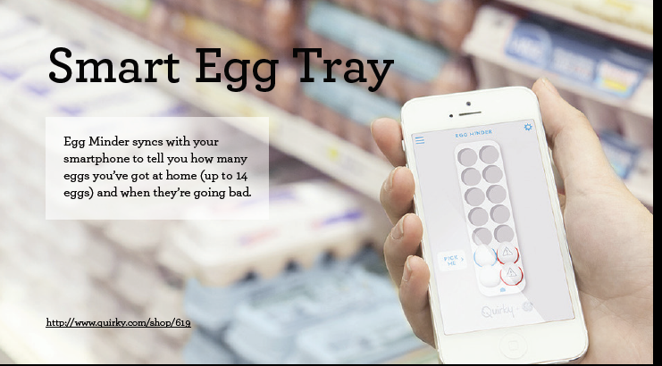

Slide 26
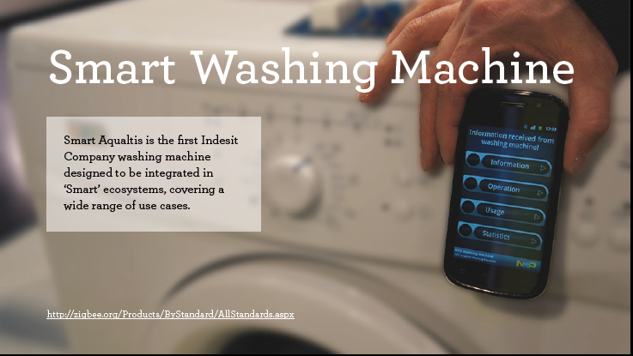

Slide 27
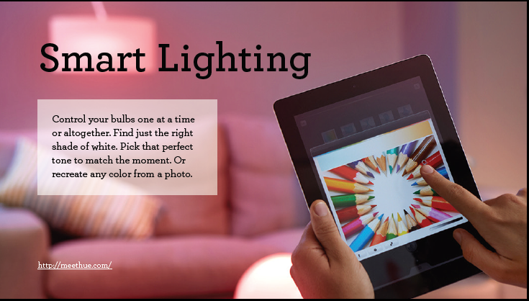

Slide 28
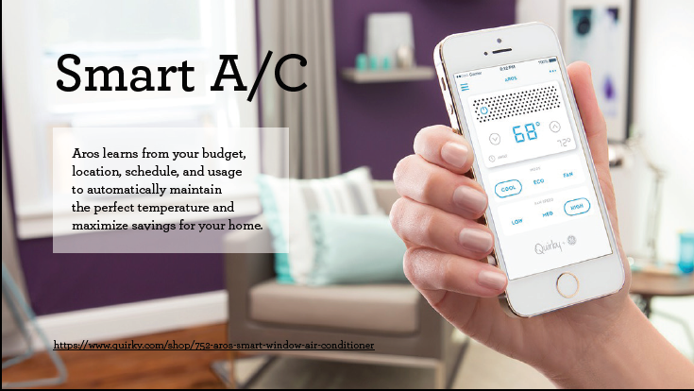

Slide 29
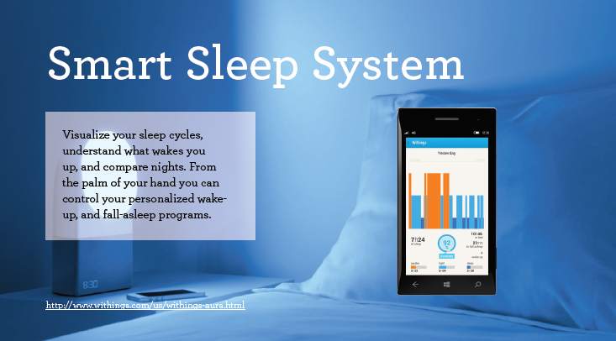

Slide 30
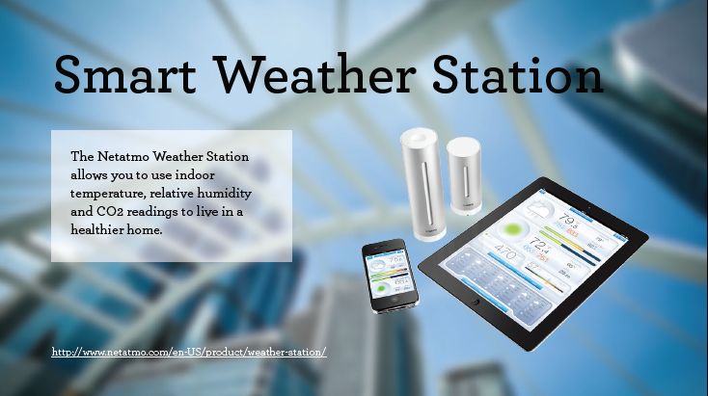

Slide 31
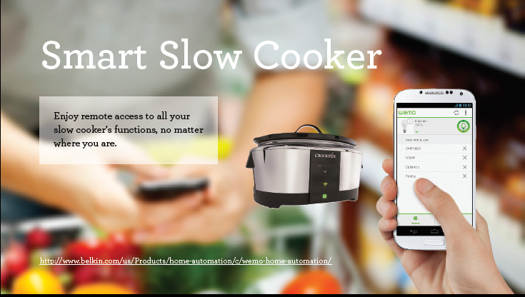

Slide 32


Slide 33


